Slide 1
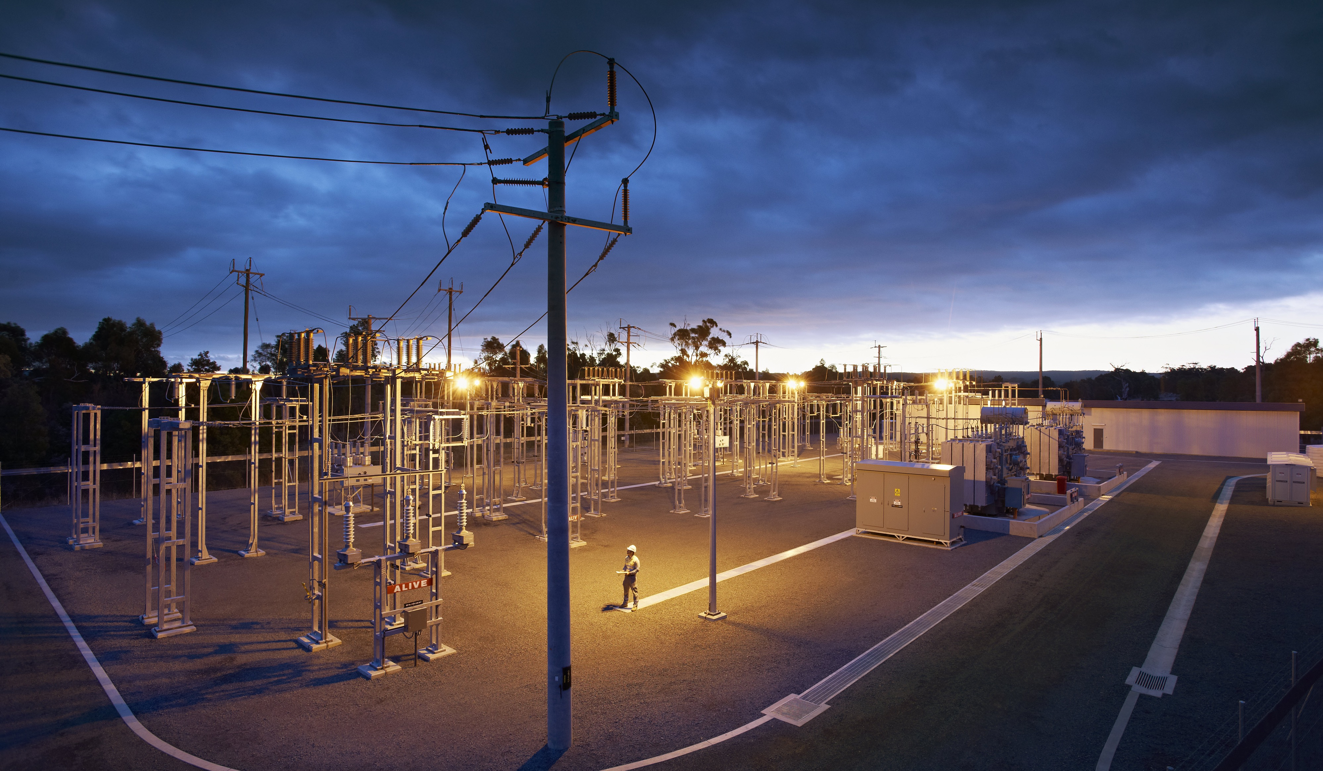
DATA SCIENCE IN A
DATA DRIVEN ENERGY ORGANISATION
Thilaksha Silva, PhD
Senior Data Scientist
Citipower, Powercor & United Energy
Shashank Kundapur
Software Developer
Operational Technology Solutions Pty Ltd

Slide 2
What is Data Science?

Slide 3
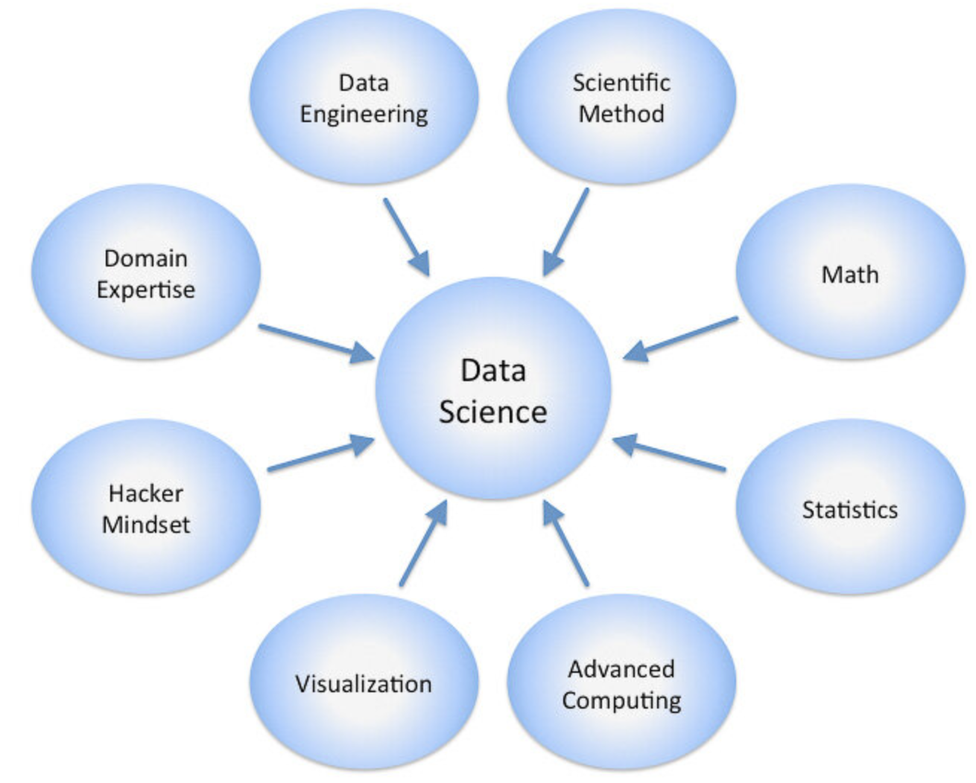
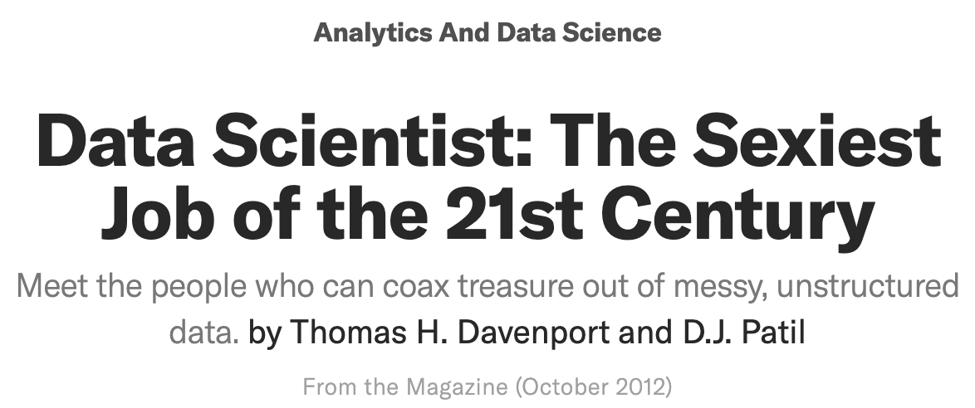
Data Science
Big data
Manage and mine the data
Create insights from data
Actionable business outcomes
3

Slide 4
Who are we?

Slide 5
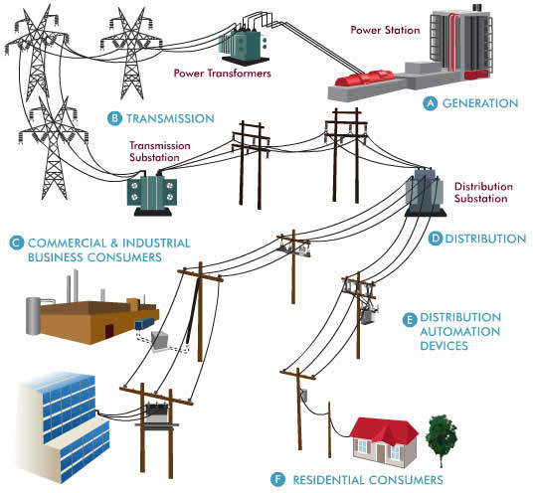
Distribution
5

Slide 6
Our databases

Slide 7
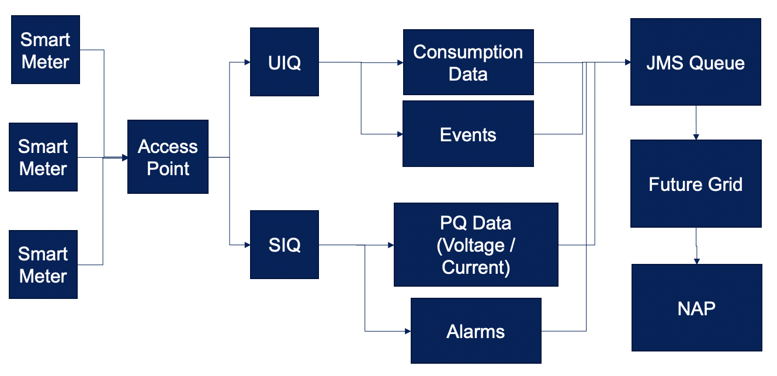
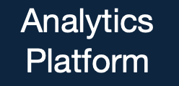
Analytics Platform - Meter data
7

Slide 8
Our Smart Meter Population
Over 1.8 million active smart meters in our Advanced Metering Infrastructure (AMI) Smart Meter Network
350 million records per day
65 GB of new data per day and 23.8 TB per year
99.93% of consumption reads delivered daily
We get 5-minute and 10-second voltage, current and power factor profile data of every smart meter in the network providing a time synced real-time snapshot of the whole network
Few ‘000 customers on 1-min profile data collected every 5 min
15 carefully selected alarms to identify potential fault conditions
8

Slide 9
We exploit data science, big data and analytics

Slide 10
LV-DERMS Demand Response Management

Slide 11
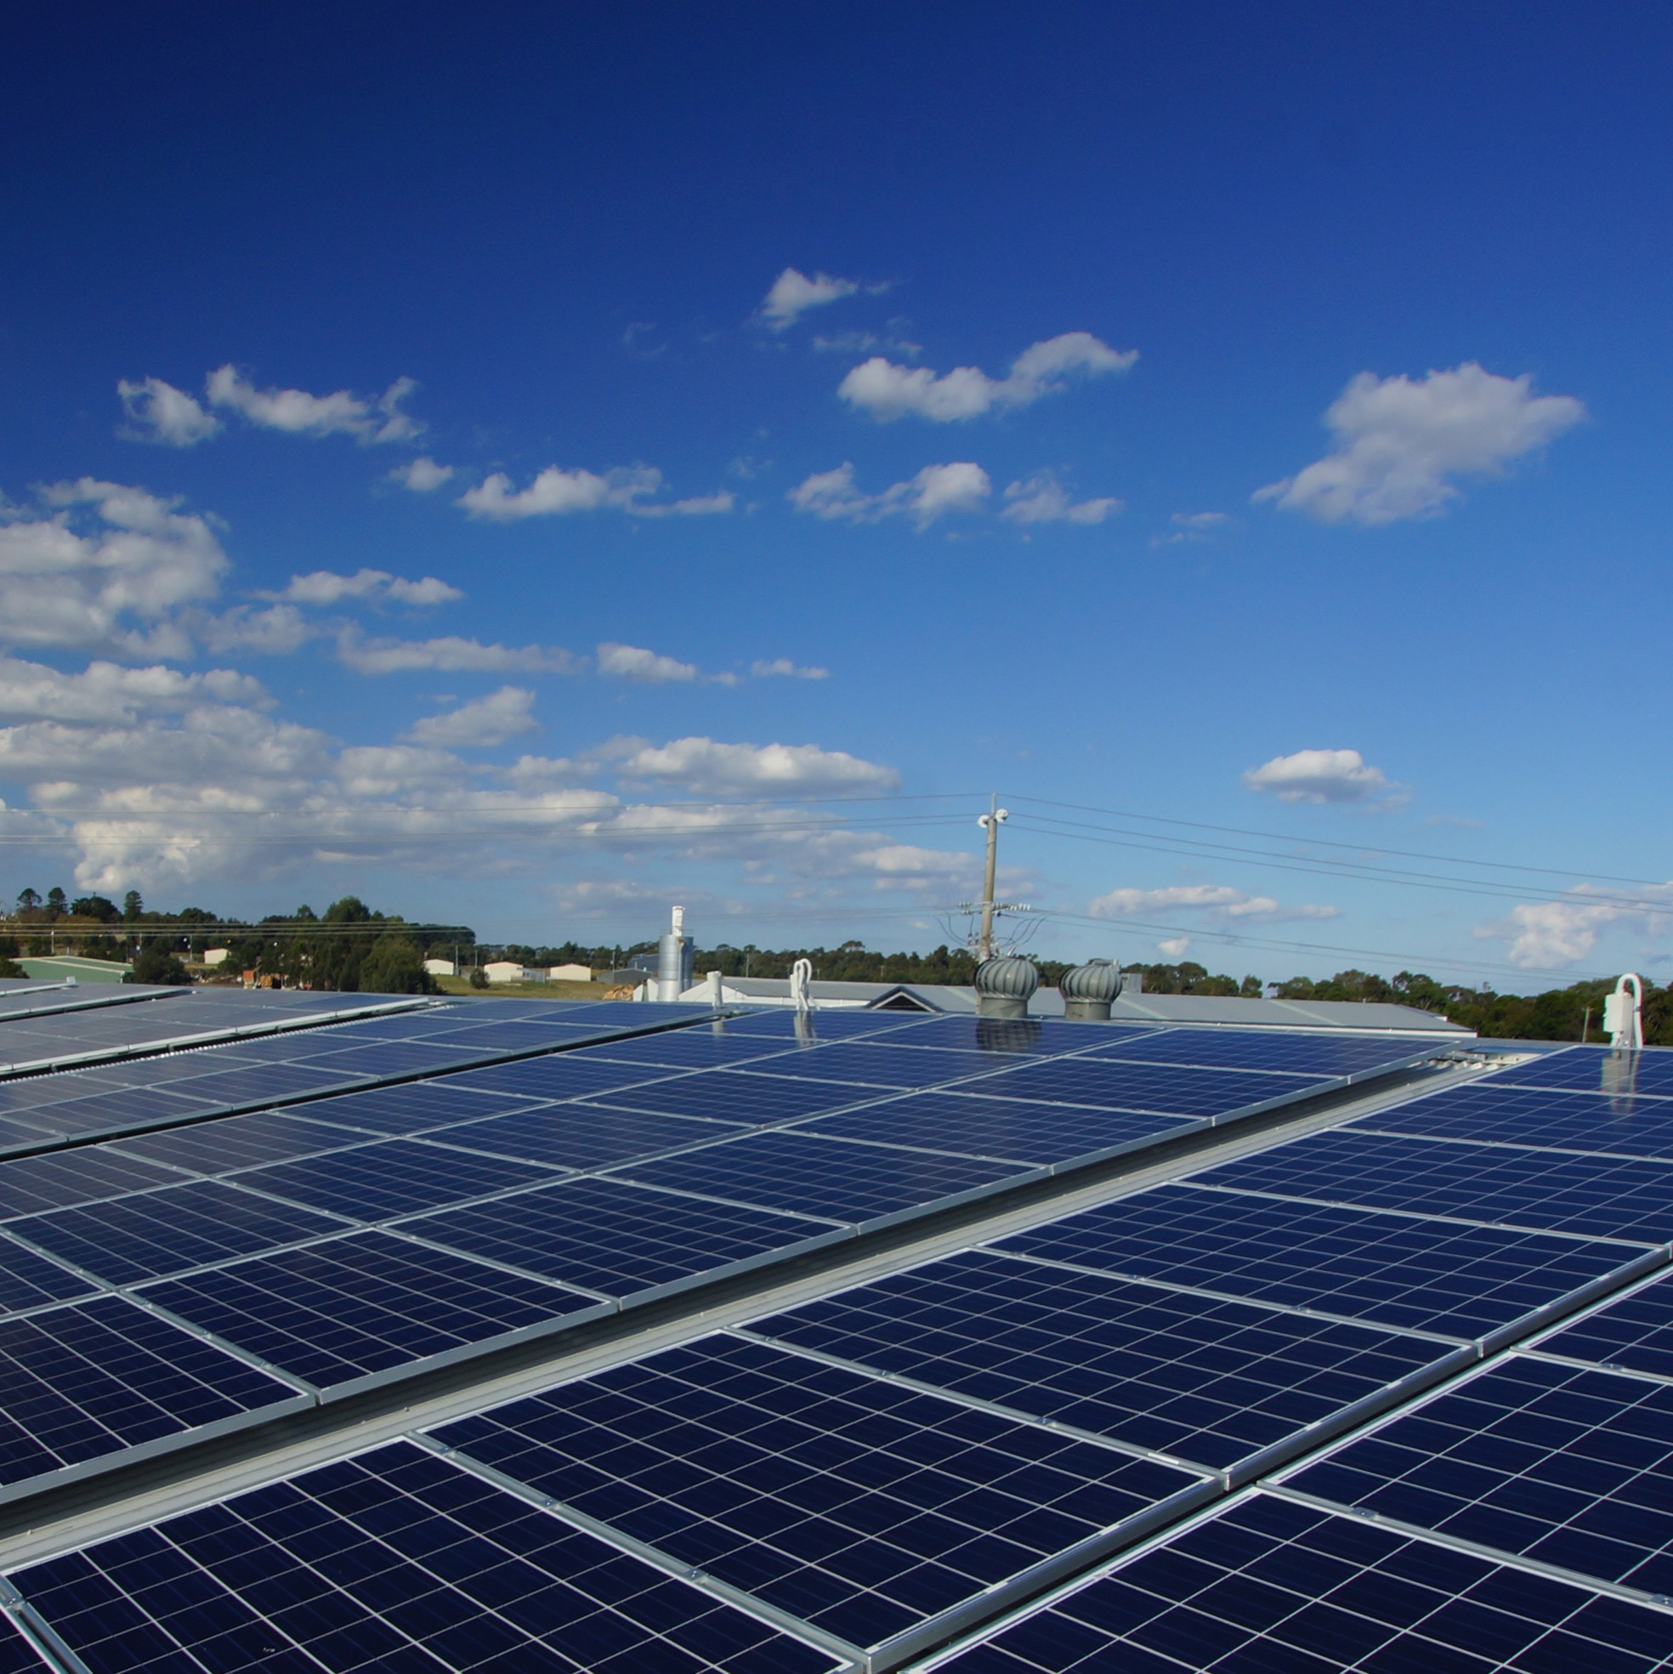

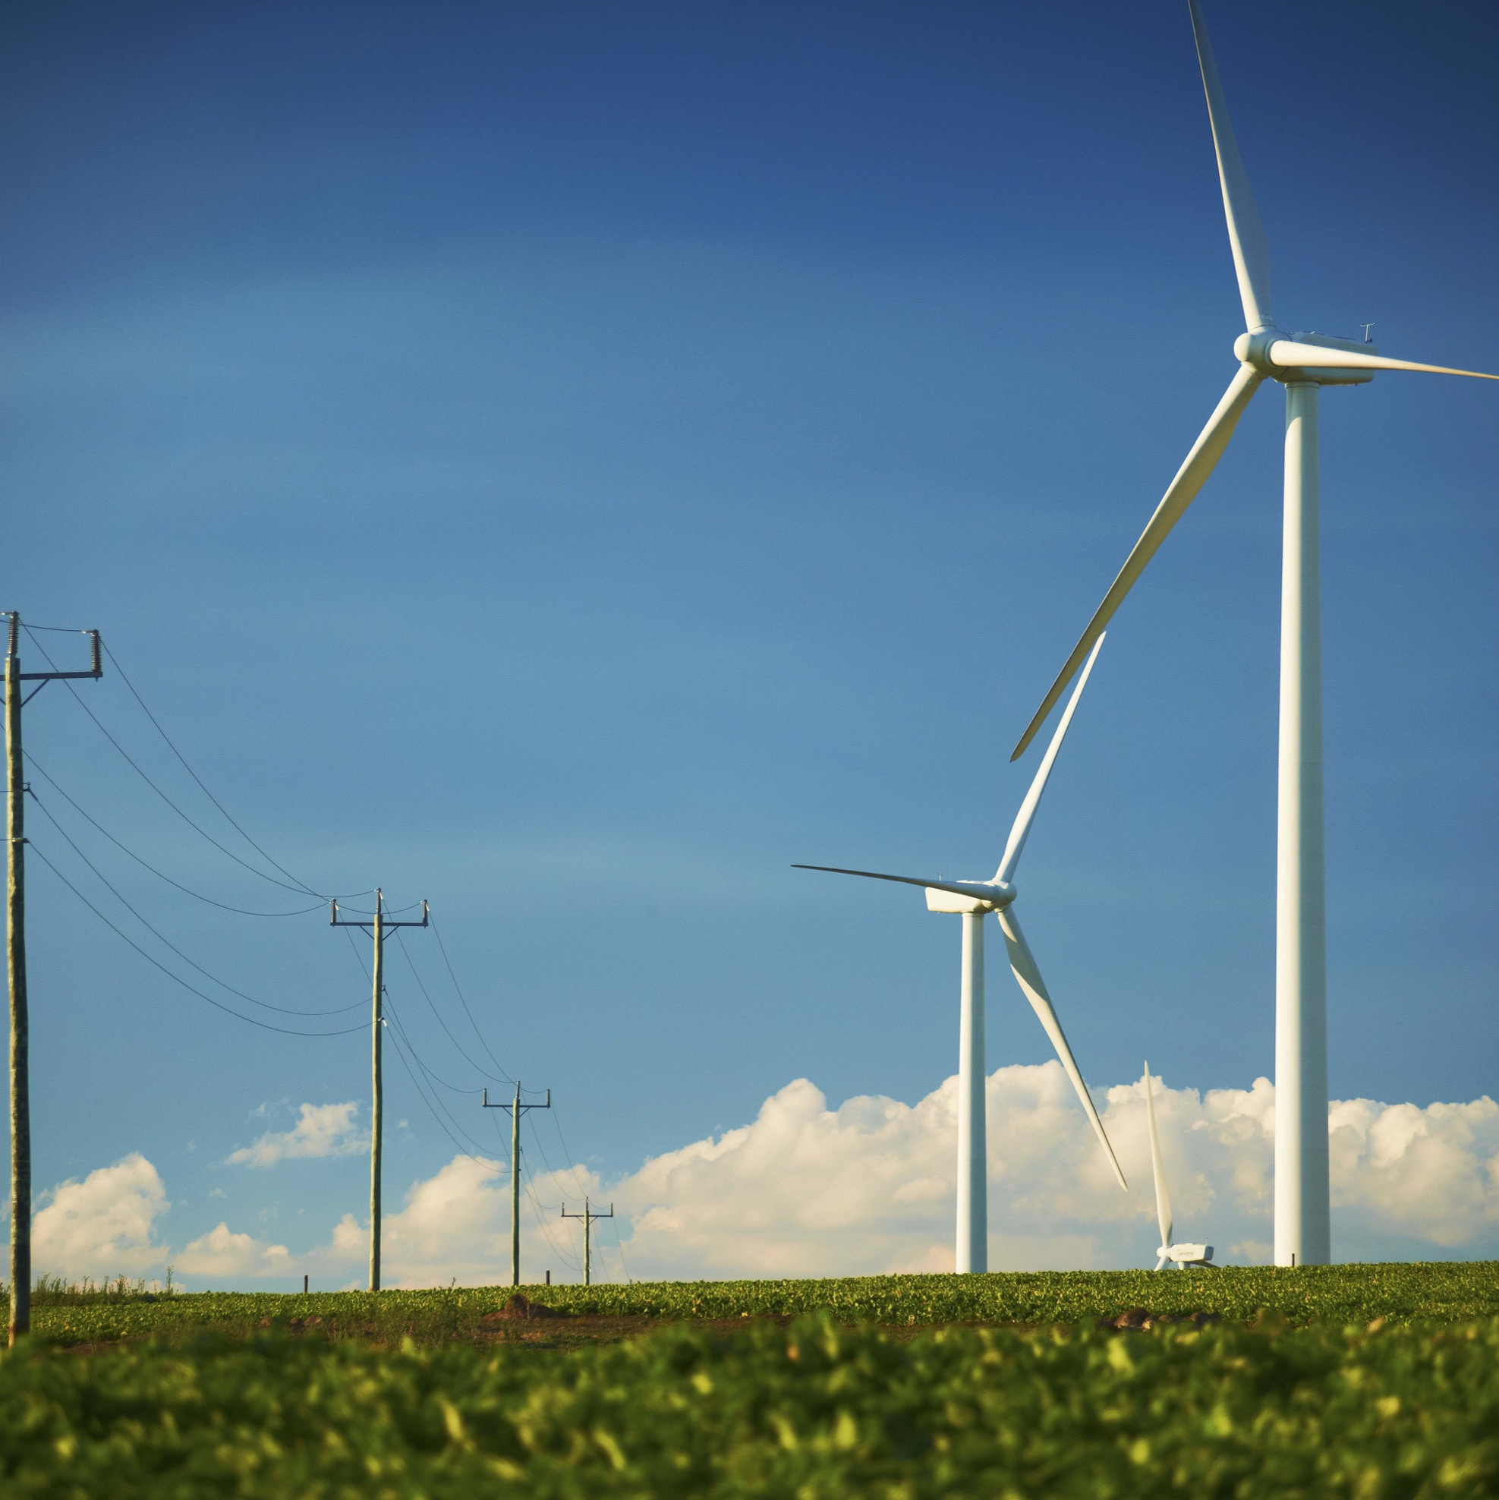
LV-DERMS demand management
The LV-DERMS project was initiated to ease constraints during times of high demand e.g., seasonal peaks:
managing the residential demand during peak periods
HOW?
adjust customers’ air conditioners for a few hours
on a few really hot days over summer when the electricity demand is at its peak
By controlling the customers AC consumption, we control the load on the LV network during peak demand periods to help balance the grid.
Ensure a safe and reliable network which ultimately prevents customer outages.

Slide 12
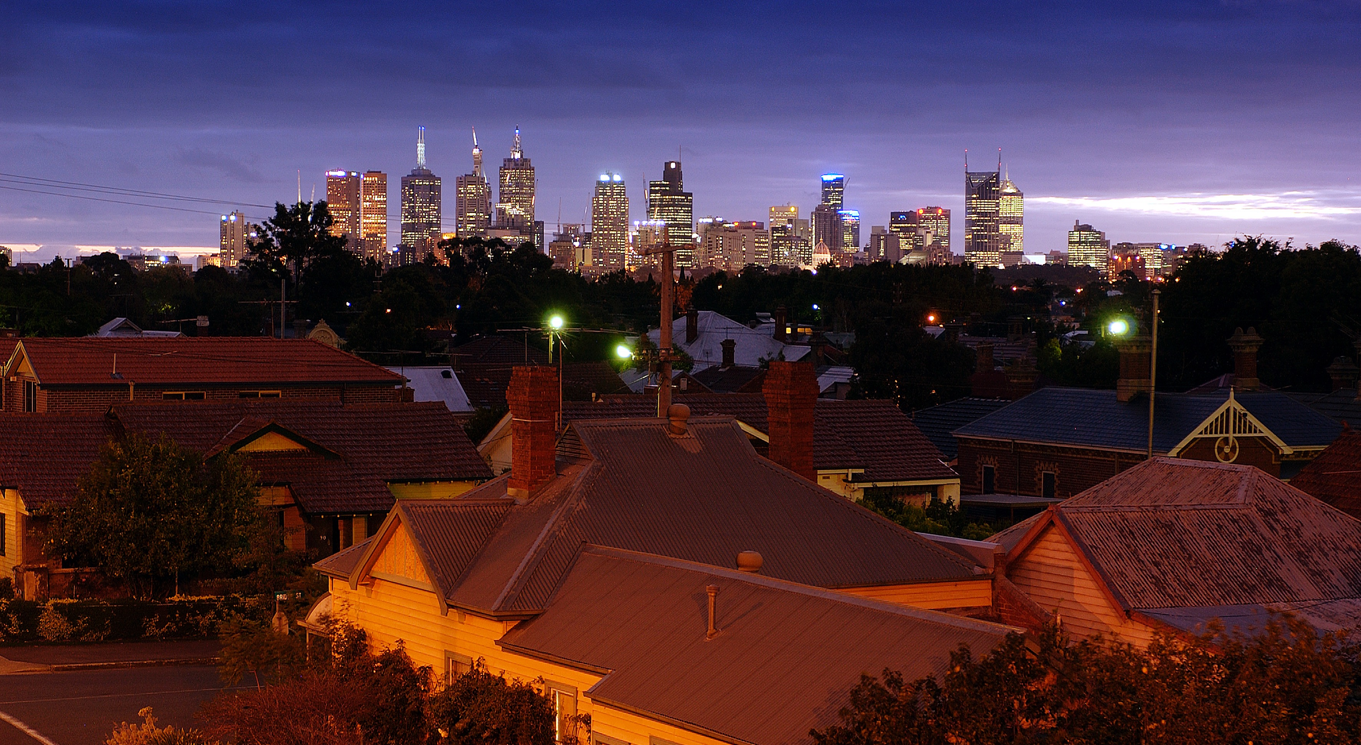
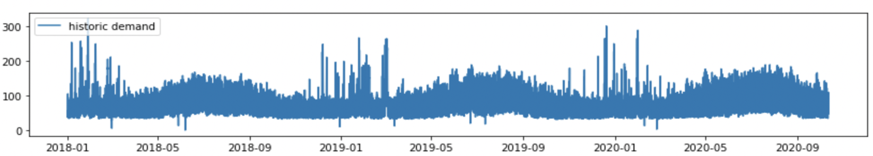
Objective
For identified distribution substations, we forecast hourly demand for the next 48 hours
Data
Historic demand
half-hourly aggregated demand from 2018-01-01 to 2020-10-12 for each distribution substation
Historic weather
half-hourly weather observations from 2018-01-01 to 2020-10-12 for all weather zones in Victoria
Forecast weather
hourly weather forecast for the next 14 days for all weather locations in Victoria
12

Slide 13
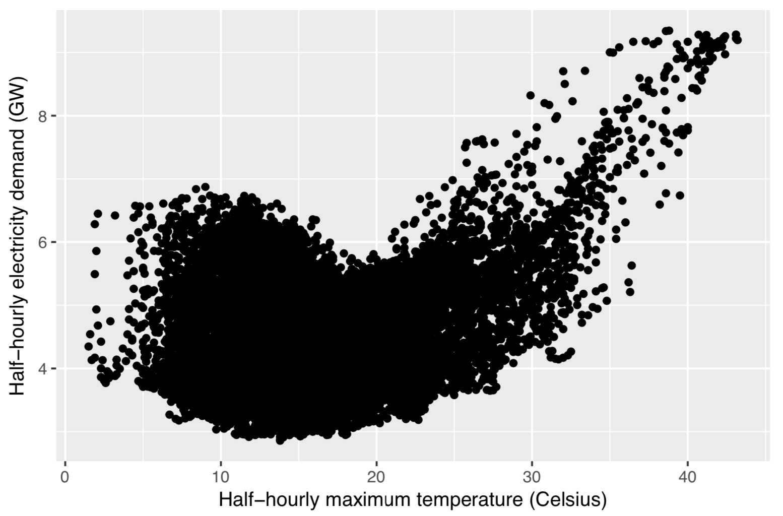
Demand drivers
A random forest regression model is trained given weather and calendar features:
Weather effects
current temperature
current temperature squared
temperature from the same time period of the previous day
temperature from 6hrs before
maximum temperature in the last 24hrs
minimum temperature in the last 24hrs
wind speed
Calendar effects
day of week effect (to handle daily seasonal pattern)
hour of day effect
month of year effect
public holiday effect
school holiday effect
covid effect



Electricity demand can be modelled as a non-linear function of temperature as more electricity is used on cold days due to heating and hot days due to air conditioning.

Slide 14
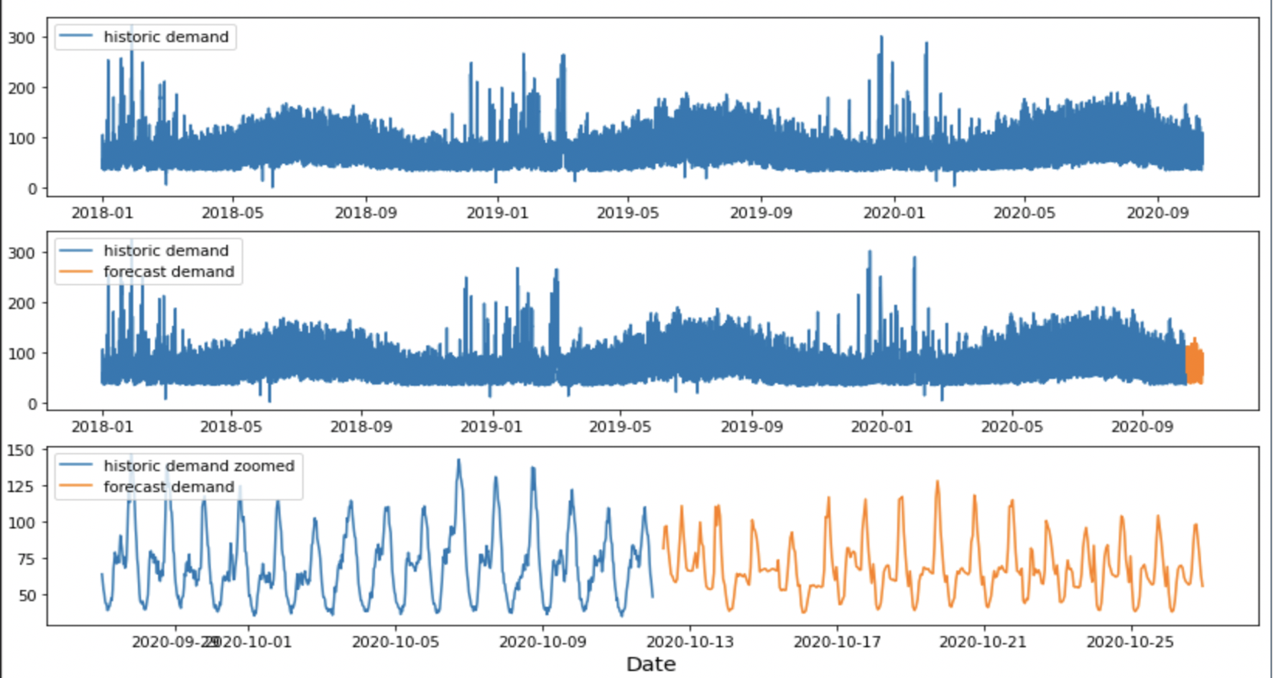

Slide 15
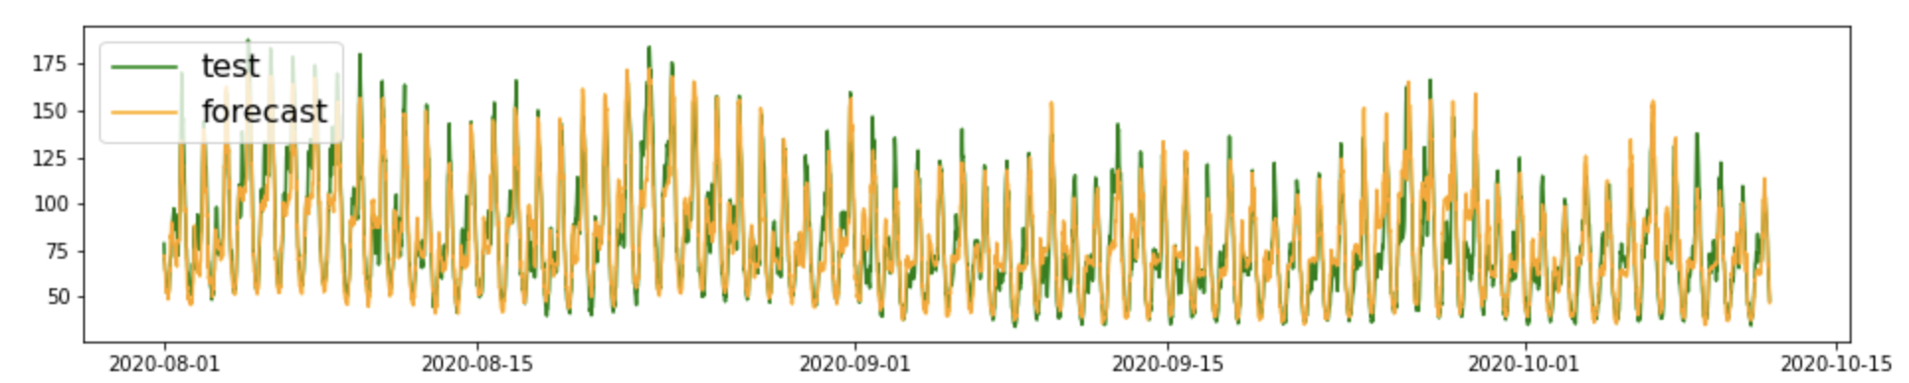
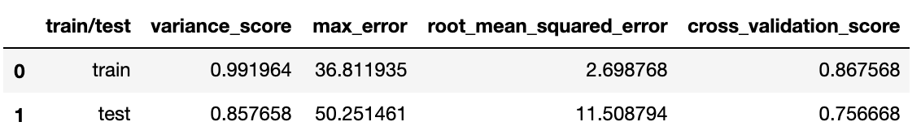
Evaluating the quality of model’s predictions
The quality of forecast demand is evaluated using regression metric functions and cross validation score:

Slide 16
Network Outage Forecasting

Slide 17
Resource Forecasting & Storm Impact – 2 day ahead forecast
Forecast
Outages
Faults per area
Trucks required per area
When are Trucks required?
Calls to Call Centre
USAIDI Impact = $
Network load
North
Central
DMS Faults Data
12 years of data
Resources requirements
& Input Notification
Weather Data
Machine Learning
South
History + Forecast

Slide 18
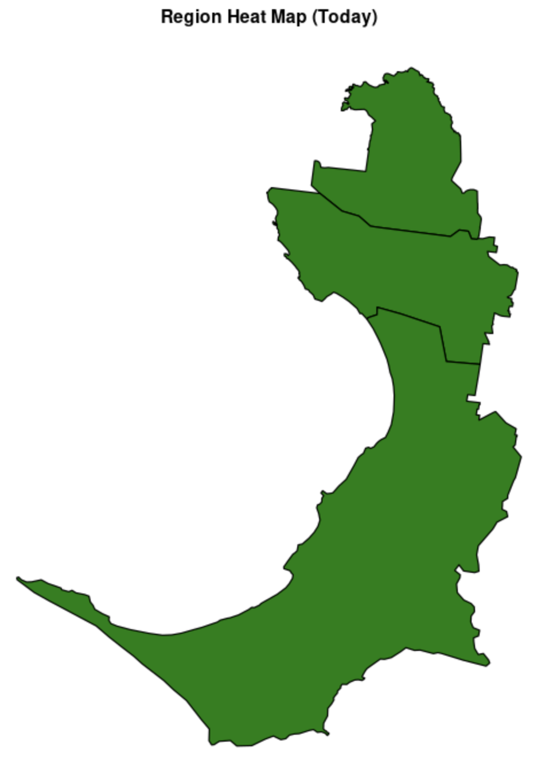
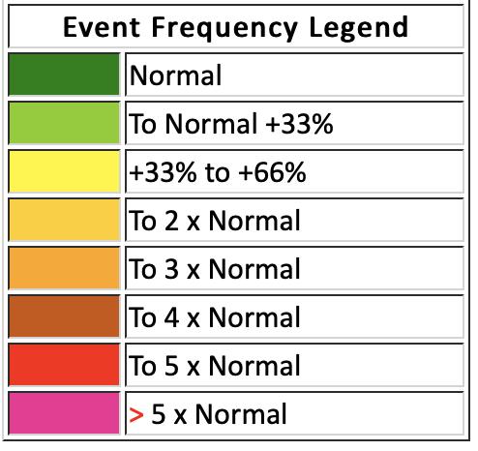
Objective
Forecast the number of network outages for regions in the electricity distribution network.
Features
Historical outage data
Historical weather observation
Temperature
Wind
rainfall
Hourly weather forecast
Calendar effects:
Weekday
Weekend
public holiday
18

Slide 19
Network Fault Detection

Slide 20
Neutral Fault Detection

Slide 21
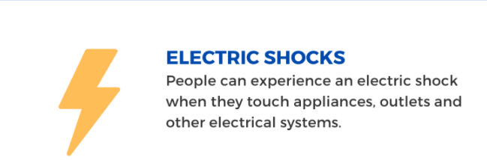
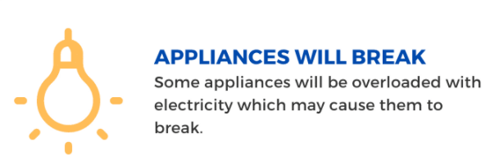

Neutral Fault
When a Neutral wire of electricity system becomes disconnected or damaged and cannot carry current anymore.
Power flows into the premise via an active cable and leaves via a neutral cable. However, if there is no neutral, this could cause an influx of voltage. A neutral issue can cause serious issues to the equipment which can be irreparable and possible life-threatening situation.
Causes of Loss of Neutral are weather, animal, poor installation or corrosion
Notes:
Information Retrieved from
https://www.thelocalelectrician.com.au/what-is-a-broken-neutral-wire/
https://www.sollatek.com/loss-of-neutral/

Slide 22
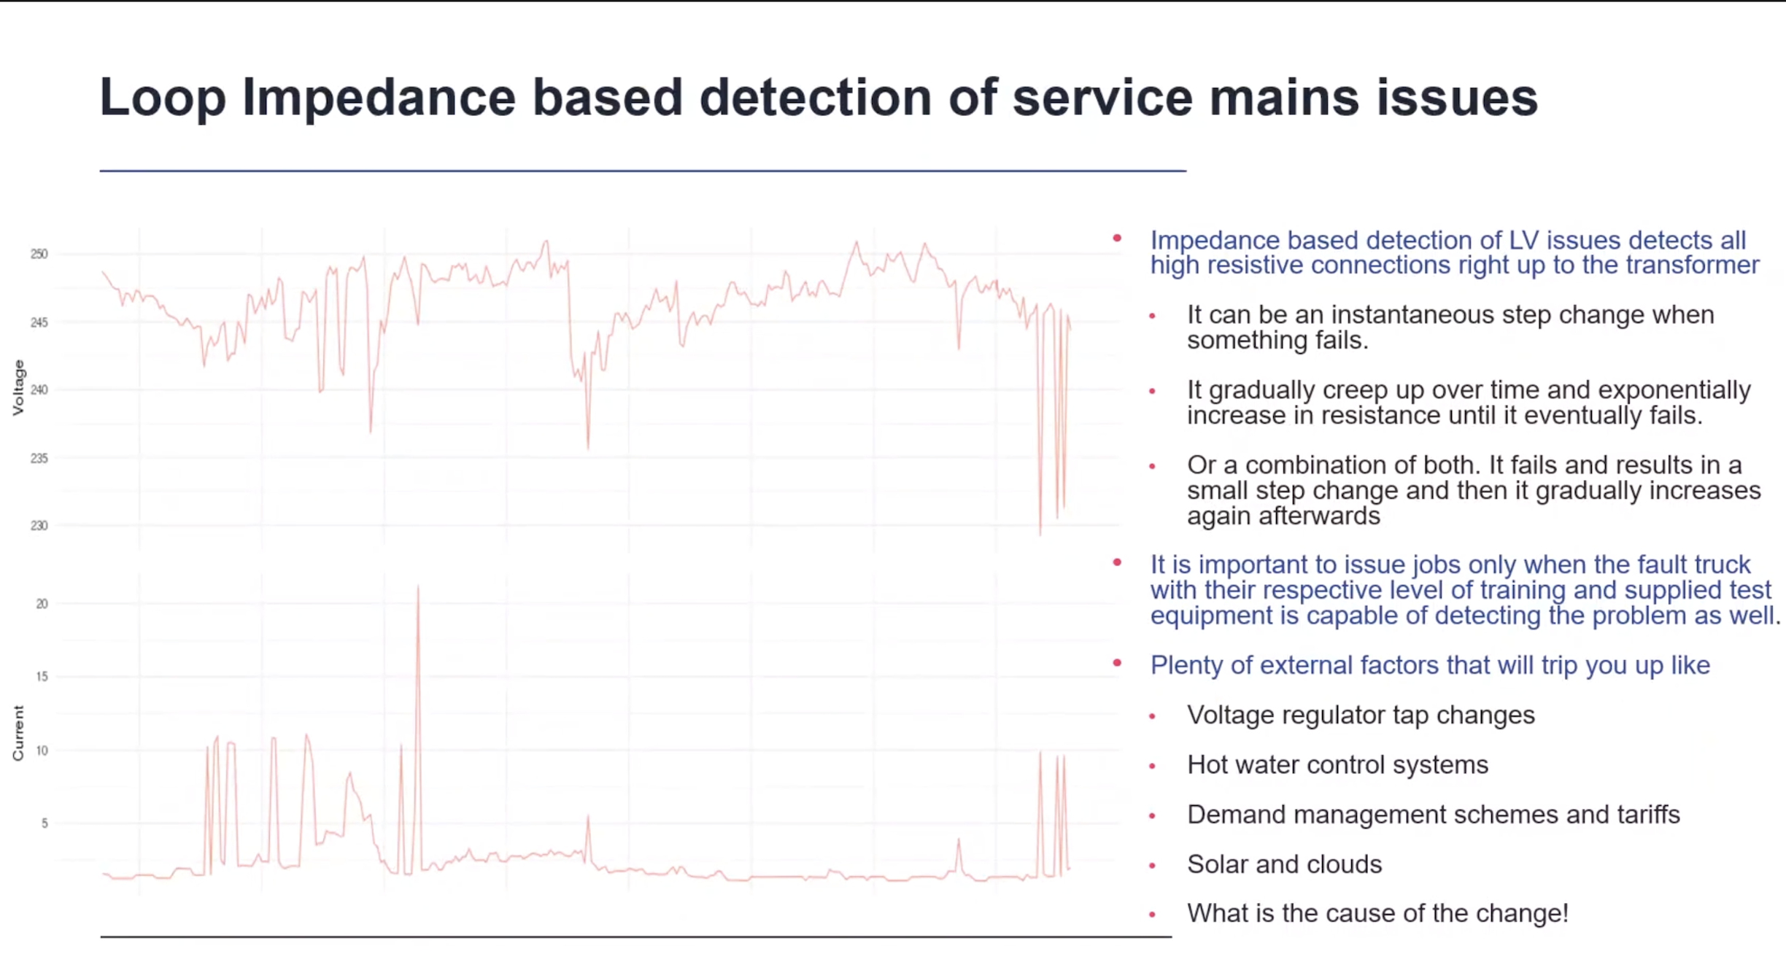
Detect network faults right up to the transformer
22

Slide 23
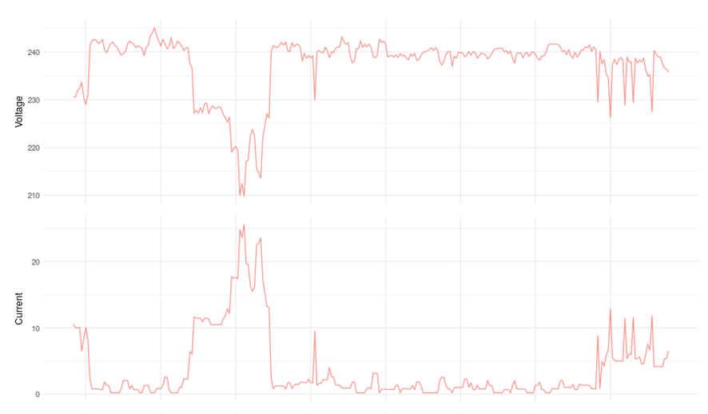
Example: Near Real-Time Analytics
Detection Mechanism
Based on the smart meter channel reading with voltage and current profile.
For every drop in voltage, we can clearly see a rise in the current.
Calculate the number of times this happens in the day and if the thresholds do reach then raise it an as job to fix.
Outcome of this Jobs
Correlation Between Voltage & Current

Slide 24
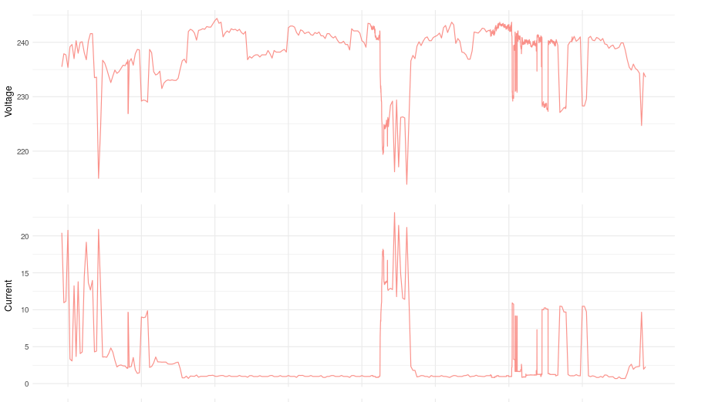
Example: Near Real-Time Analytics
Detection Mechanism
Based on the smart meter channel reading with voltage and current profile.
For every drop in voltage, we can clearly see a rise in the current.
Calculate the number of times this happens in the day and if the thresholds do reach then raise it an as job to fix.
Outcome of this Jobs

Slide 25
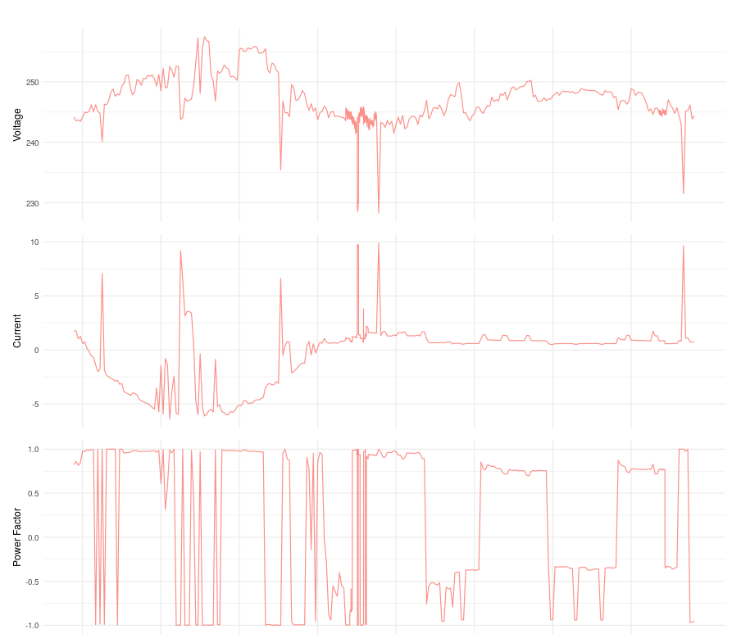
Example: Near Real-Time Analytics
Detection Mechanism
Effects of DER Devices in Loss of Neutral Detection.
Voltage and Current exhibit the same behavior.
For every drop in voltage, we can clearly see a rise in the current.
We do have to sometime wait for the clouds to clear for the jobs to reach the threshold as the current would be negative.

Slide 26
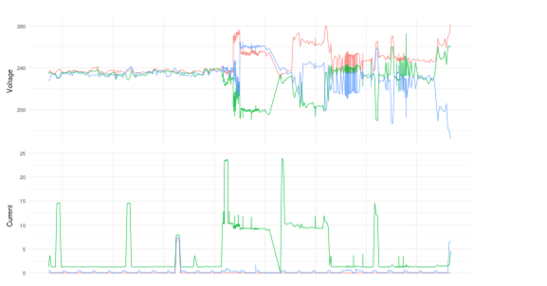
Example: Near Real-Time Analytics (High Voltage)
Detection Mechanism
Based on the smart meter channel reading with voltage and current profile.
For every rise in voltage, we record for every over voltage and count the number of time the voltage was over the threshold. If the voltage is too high, we would disconnect the customer
Outcome of this Jobs/Comments – “Repaired neutral connection at service pole due to corrosion. Tested and re energised meter. Customer is happy appliances now working properly.”

Slide 27
HV Fuse Issue/Brownout

Slide 28
Potential Brownout Detection
When the Fuse is Blow or if the HV Conductor is broken we normally have multiple customer on the substation which would see power outage.
Raising Faults to DMS will enable them to track down the exact location of fault.
Helps to act on the fault before the customer calls.

Slide 29
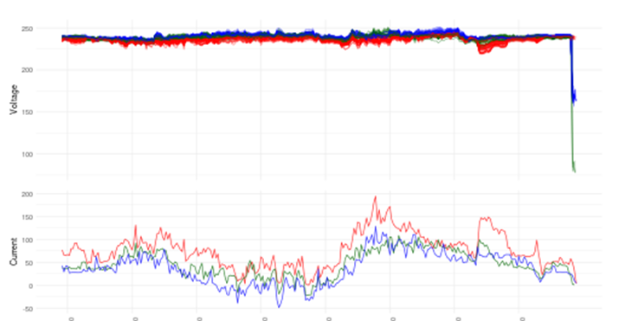
Example: Near Real-Time Analytics
Detection Mechanism
Based on the smart meter channel reading with voltage and current profile.
For every drop in voltage, we will calculate the number of times the customer saw the voltage drop.
If certain percentage of customer on the substation notice the issue. We would raise a Potential Brownout Fault.
Outcome of this Jobs/Comments – “Replaced 15E BA fuse white phase. Caused by possum on TX bushing. Wood pole with animal proofing fitted. NO FIRE.

Slide 30
System Automation

Slide 31
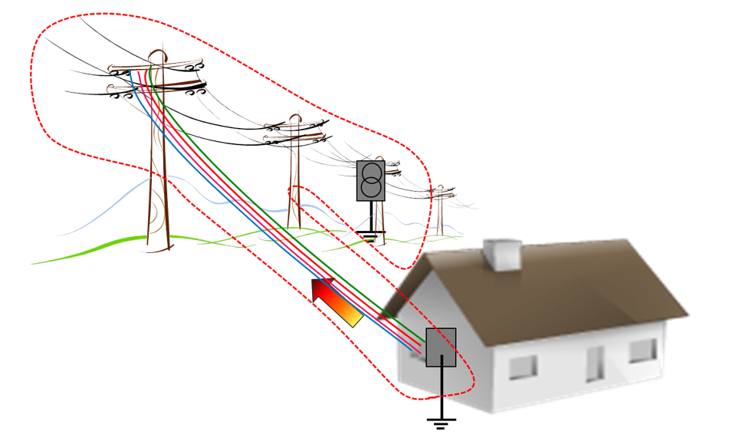
Automated Monitoring Of Service Mains

Slide 32
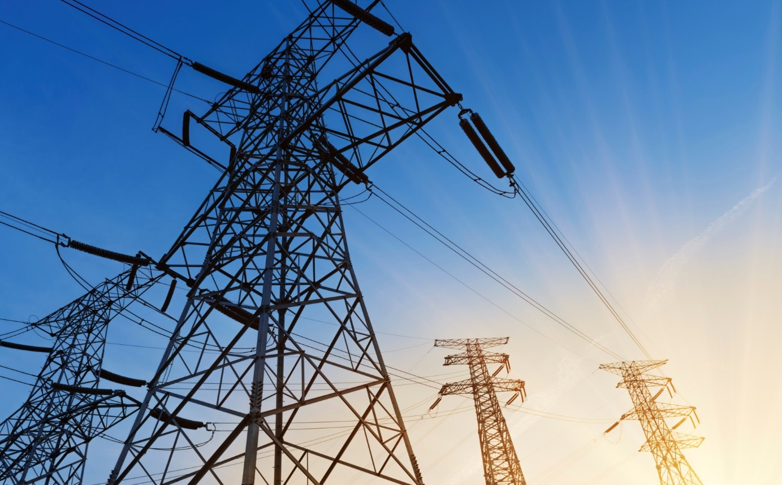
Automated Monitoring Of Service Mains
3 deaths across Australia could be attributed to a Loss of Neutral supply
Regulators across states have increased the required frequency of meter inspections to address this risk
Regulators across states have increased the required frequency of meter inspections to address this risk
United Energy needs to inspect 650k services every 10 years:
Current on-site inspections are costly
“Frequent” inspections still do not address the risk for failure between inspections. An inspection just detect failures since the last inspection
In addition, significant cost incurred to investigate customers who report loss of neutral every year, especially if they receive a shock
Our remote monitoring tool checks and measures the service line quality and associated risks every hour (configurable) to flag changes in service main health.
658k meters monitored every hour
Change of health monitored and cases automatically issued to DMS
No more on-site neutral inspections
1950 lines proactively fixed since Jan ’16
Now at 98% success rate
Benefits
Reduced our annual on-site inspection cost by $’m per year
Reduced our shock incidents by more than 70%, compared to the last 5 years average

Slide 33



Network Fault Dispatch – Analytics Raising Jobs to DMS
ZSS
RTS
Field Mobility
P1
:
P6
Job issue
iPad
iPad
SCADA
DMS
Raise Job
Data/Graphs requests
On Dispatch Supporting details
On Dispatch SMS Customer
Analytics
DMS Jobs
20 Min to 2h
Customer Service
AMI
Comms
Periodic 5 min AMI Data
AMI Meters

Slide 34
Network Fault Dispatch – Analytics making the supply safe
ZSS
RTS
Field Mobility
P1
:
P6
Job issue
iPad
iPad
SCADA
DMS
Raise Job
Data/Graphs requests
On Dispatch Supporting details
On Dispatch SMS Customer
Notify Call Centre
Call Customer
NAP
DMS Jobs
Bad
3 – 20+ min
Customer Service
Disconnect Supply
AMI
Comms
Periodic 5 min AMI Data
AMI Meters

Slide 35
Value of Real Time 10 Second Data Analytics

Slide 36
Background Information
Need for Speed
Experienced few cases where customers received shocks or experienced equipment damage after a job has been issued and/or just before a safety disconnect occurred.
Normally noticed after the fault was for around 20 minutes after which the customer was disconnected.
Subsequent Action Taken
New SIQ firmware deployed to all smart meters upgrading them to have up to 3 x SIQ profiles
2 Profiles deployed on all smart meters. 5 min, now being read every 15 minutes and 10 second profiles being read on demand as required
16 “smart” alarms deployed to every smart meter for real time alerts of potential network faults or safety related conditions

Slide 37
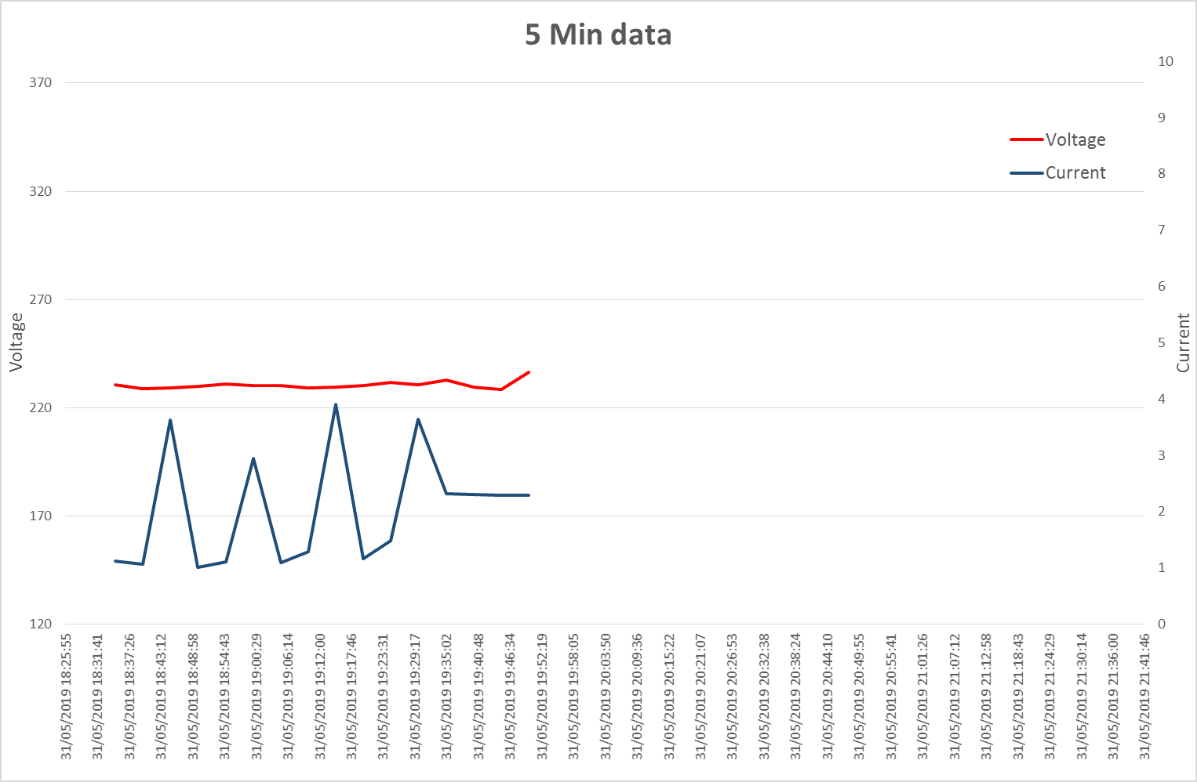
10 Sec Data Retrieved For As Long As Safety Condition Exists
Sample Scenario
5 Min data received up to 19:55 and all normal. Next data due after 20:10
19:59:01 – Smart Alarm raised from SIQ in communications card
20:00 – Analytics Team analyses alarm and severity and request 10s profile data from meter
Receive Safety Issue Alarm and request 10s data

Slide 38
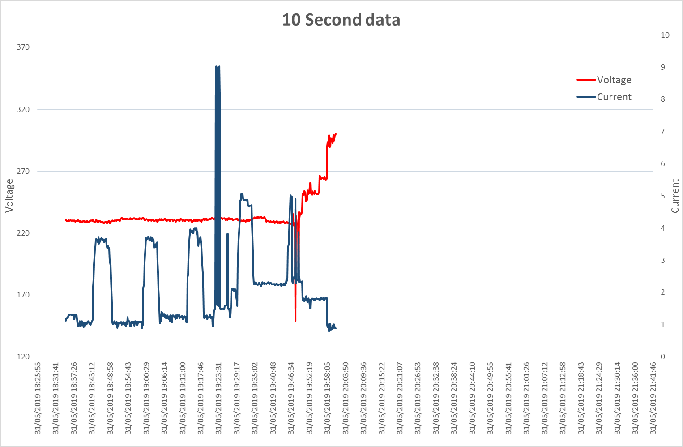
10 Sec Data Retrieved For As Long As Safety Condition Exists
Sample Scenario
5 Min data received up to 19:55 and all normal. Next data due after 20:10
19:59:01 – Smart Alarm raised from SIQ in communications card
20:00 – Analytics Team analyses alarm and severity and request 10s profile data from meter
20:02 – Analytics Team analyses 10s profile data confirm fault and severity and issue a safety disconnect
20:03:40 – Meter confirmed disconnection was successful, current dropped to 0 Amps and property is now safe
20:05:14 – Job confirmed being raised in DMS as LV backbone neutral issue (2 properties affected and disconnected)
20:05 – Analytics Team email notification to all stakeholders and Contact Center
20:25 – 2nd Notification circulated that customer called back after voice mail and is aware of circumstances
Receive Safety Issue Alarm and request 10s data
Issue Safety Disconnect

Slide 39
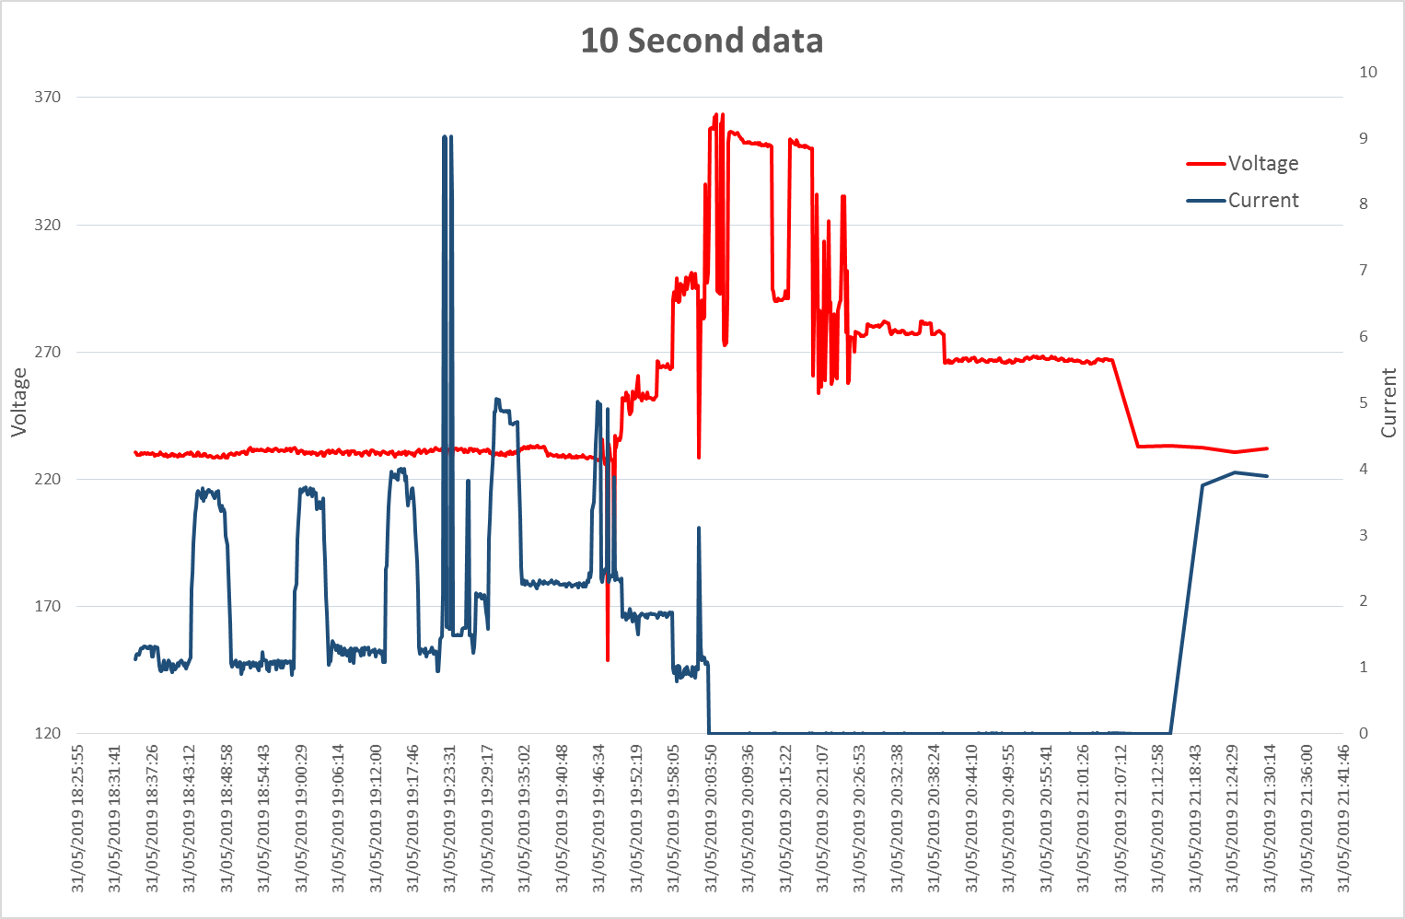
10 Sec Data Retrieved For As Long As Safety Condition Exists
20:24 – Notification circulated from Contact Center – tried to contact customer and left voice mail.
20:25 – 2nd Notification circulated that customer called back and is aware of circumstances
20:35 – Fault Crew arrive on site
21:07 – Repaired burnt out neutral @ pole
21:07 – Condition normal and NAP stop requesting 10 sec data
21:15 – Power restored
Receive Safety Issue Alarm and request 10s data
Confirmed meter disconnect
Reverts back to
5 min data

Slide 40
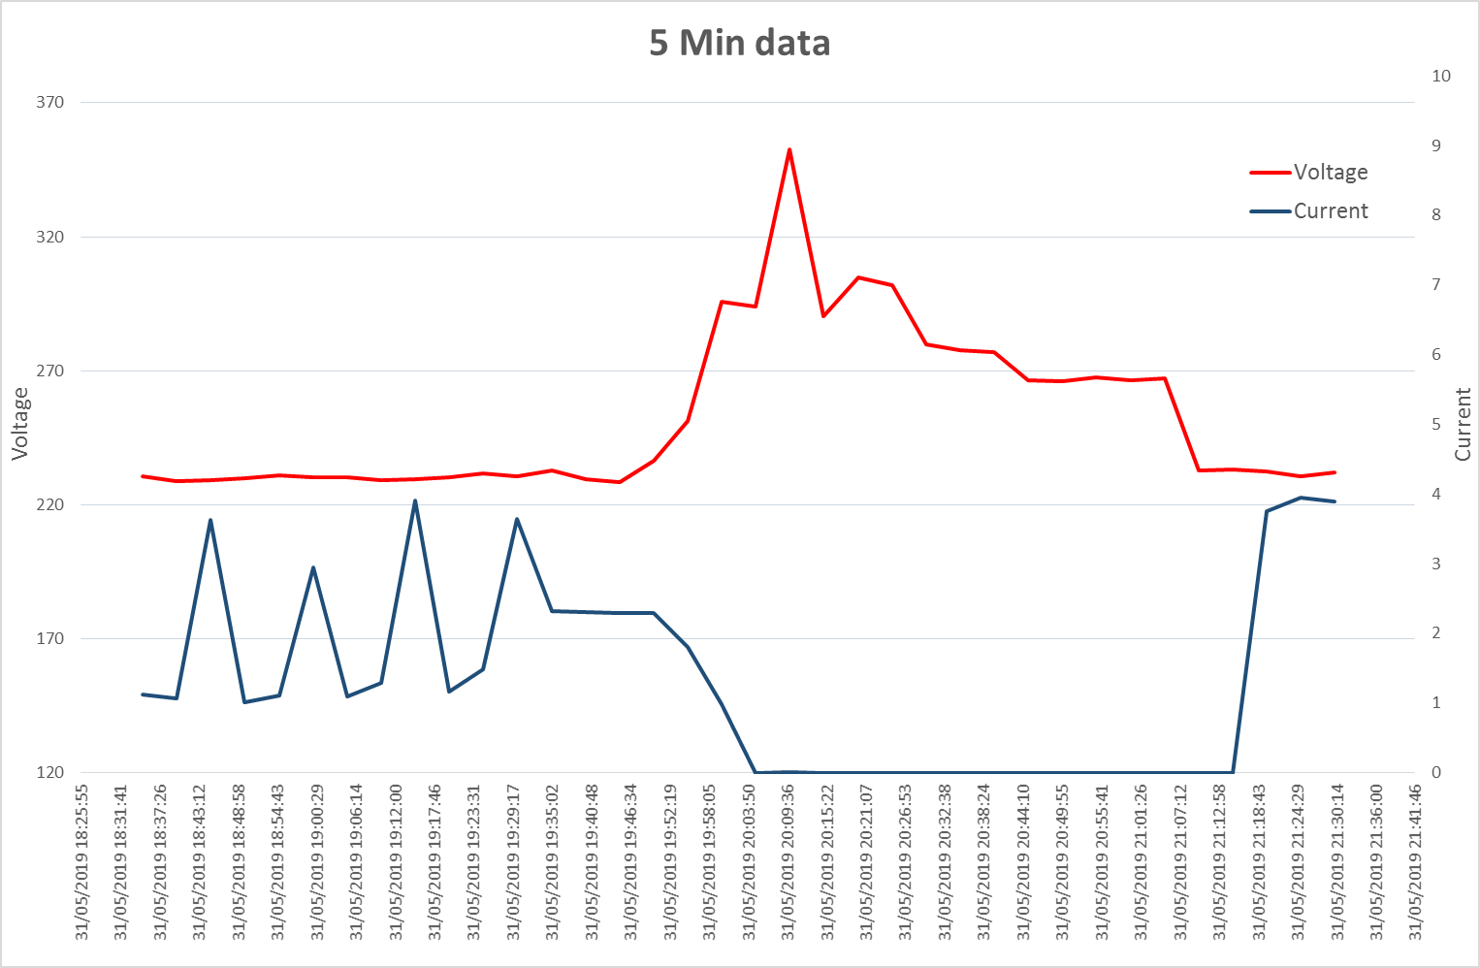
Equivalent 5 Minute Dataset
The 5 min dataset contains a lot less information (30x less than 10 sec).
Analyzing only 5 min data arriving every 15 minutes would have taken a lot longer to achieve the same validation and confirmation that it is a true fault and not a false positive

Slide 41
We make the
network safer,
more reliable and
cheaper.
We produce value
for our customers
through analytics.

Slide 42
Thank you!
Thilaksha Silva
LinkedIn profile: https://www.linkedin.com/in/thilakshasilva/
Shashank Kundapur
LinkedIn profile: https://www.linkedin.com/in/shashankkundapur/

Slide 43


